Slide 1
The Project
ECE3 Spring Quarter 2018

Slide 2
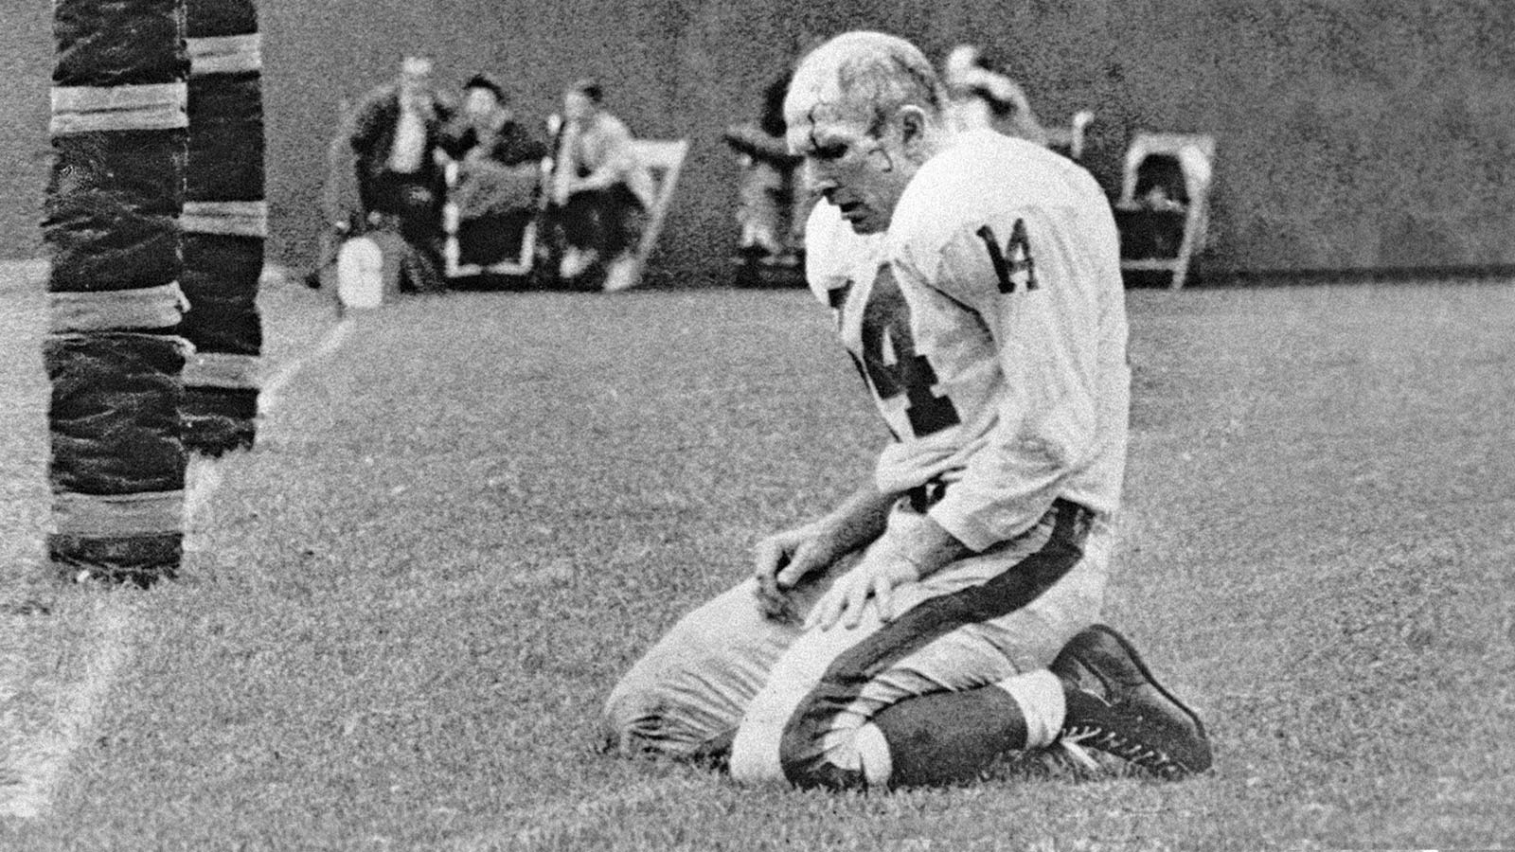
“NOTHING COMES EASY”
Book by Y. A. Tittle
1964, Age 38 (his last season)
Just threw a pick-six
NFL Hall of Fame
Photo by Morris Berman of the Pittsburgh Post-Gazette

Slide 3
Project Overview
Path-Following Mobile Robot
Goodwood Festival of Speed
Paths are “Compulsory Figures”
Two “lane changes”
Automatic stop at end
Timed events (competition for bragging rights only)
Extra Credit (for one- and two-person teams only)

Slide 4
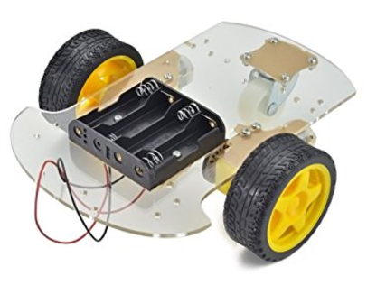
Project Overview
Path-Following Mobile Robot

Slide 5
Project Overview
DOOR
LAB TABLES
START
FINISH
WHITEBOARD
CHORD LENGTH: 11 1/8 in

Slide 6
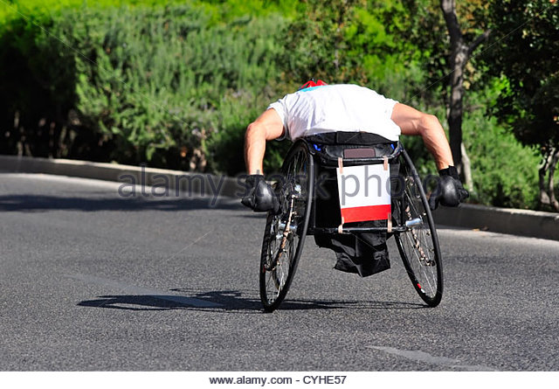
The Car
Differential steer

Slide 7
The Car
IR Path Sensing – emitter and receiver
PHOTO-
TRANSISTOR
LED
PATH
(BLACK TAPE)
WHITE SURFACE

Slide 8
Sensing Calibration
LEFT
CENTER
RIGHT

Slide 9
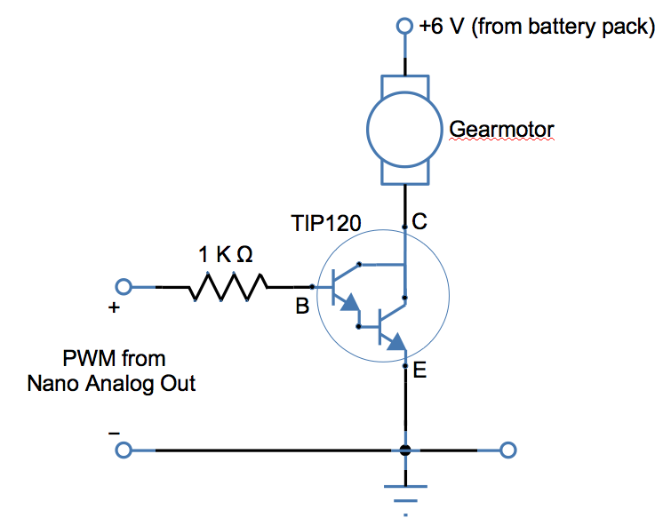
Motor Control
NPN (TIP120)
RUN: 5 V
STOP: 0 V
STOP: 5 V
1 KΩ
TIP125
RUN: 0 V
PNP (TIP125)
6 V

Slide 10
The Car
+5 V
LEDs:
Red for right turn command
Blue for left turn command
Green for straight ahead command
Red & blue for stop at end
(Extra) R,G,B flash 5/sec when wheel(s) stops
YOUR DESIGN HERE

Slide 11
The Car
Phototransistors:
Like in lab 3
Common emitter or emitter follower
Ground Color | Response
DARK | HIGH
LIGHT | LOW
Ground Color | Response
DARK | LOW
LIGHT | HIGH

Slide 12
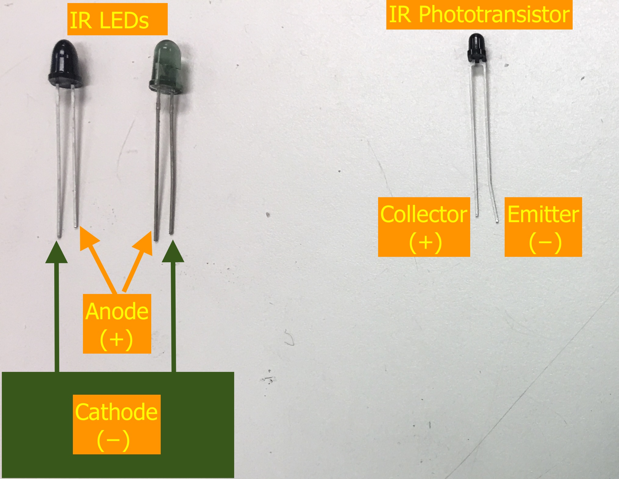
LEDs & Phototransistors
TEFT4300
SFH4545

Slide 13
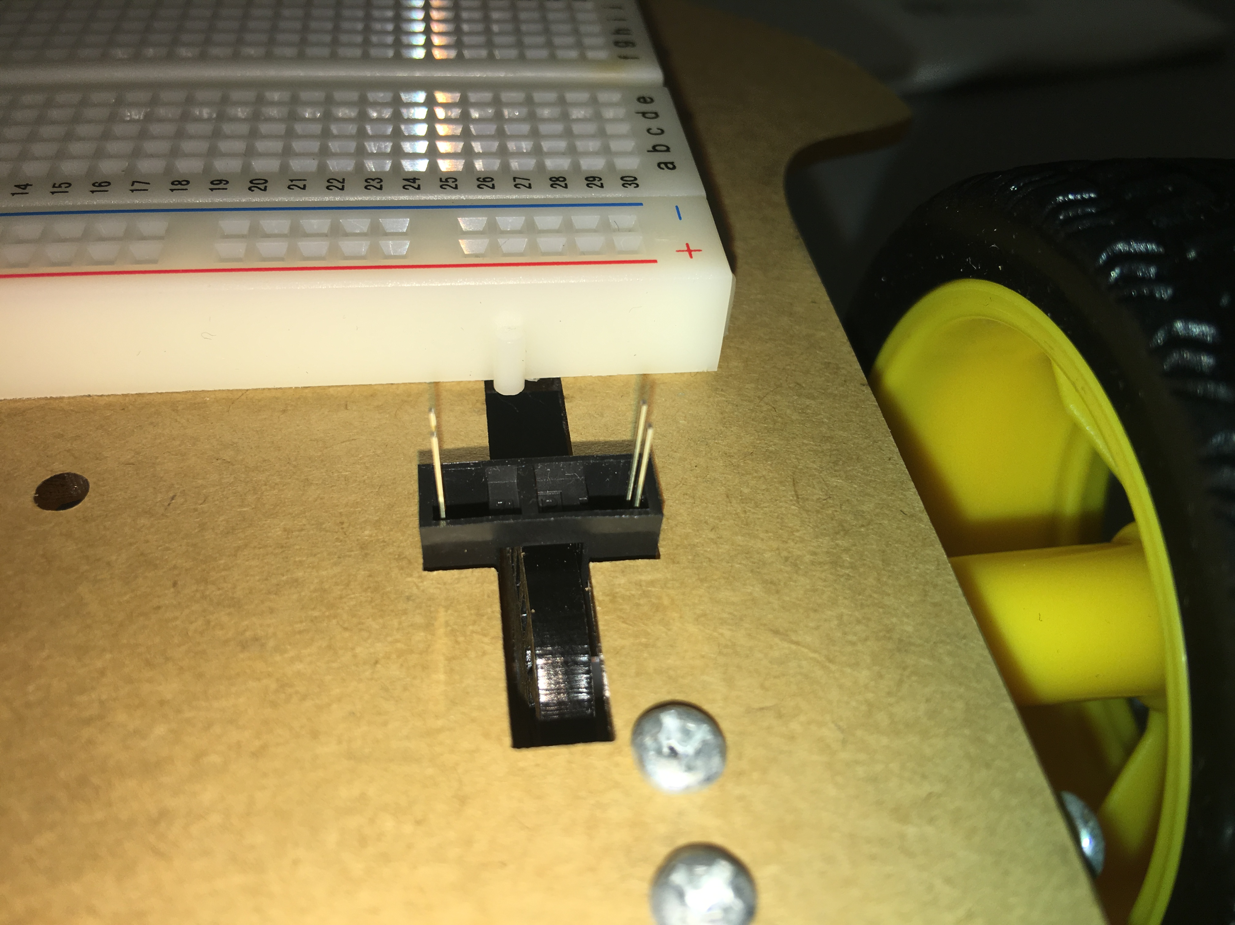
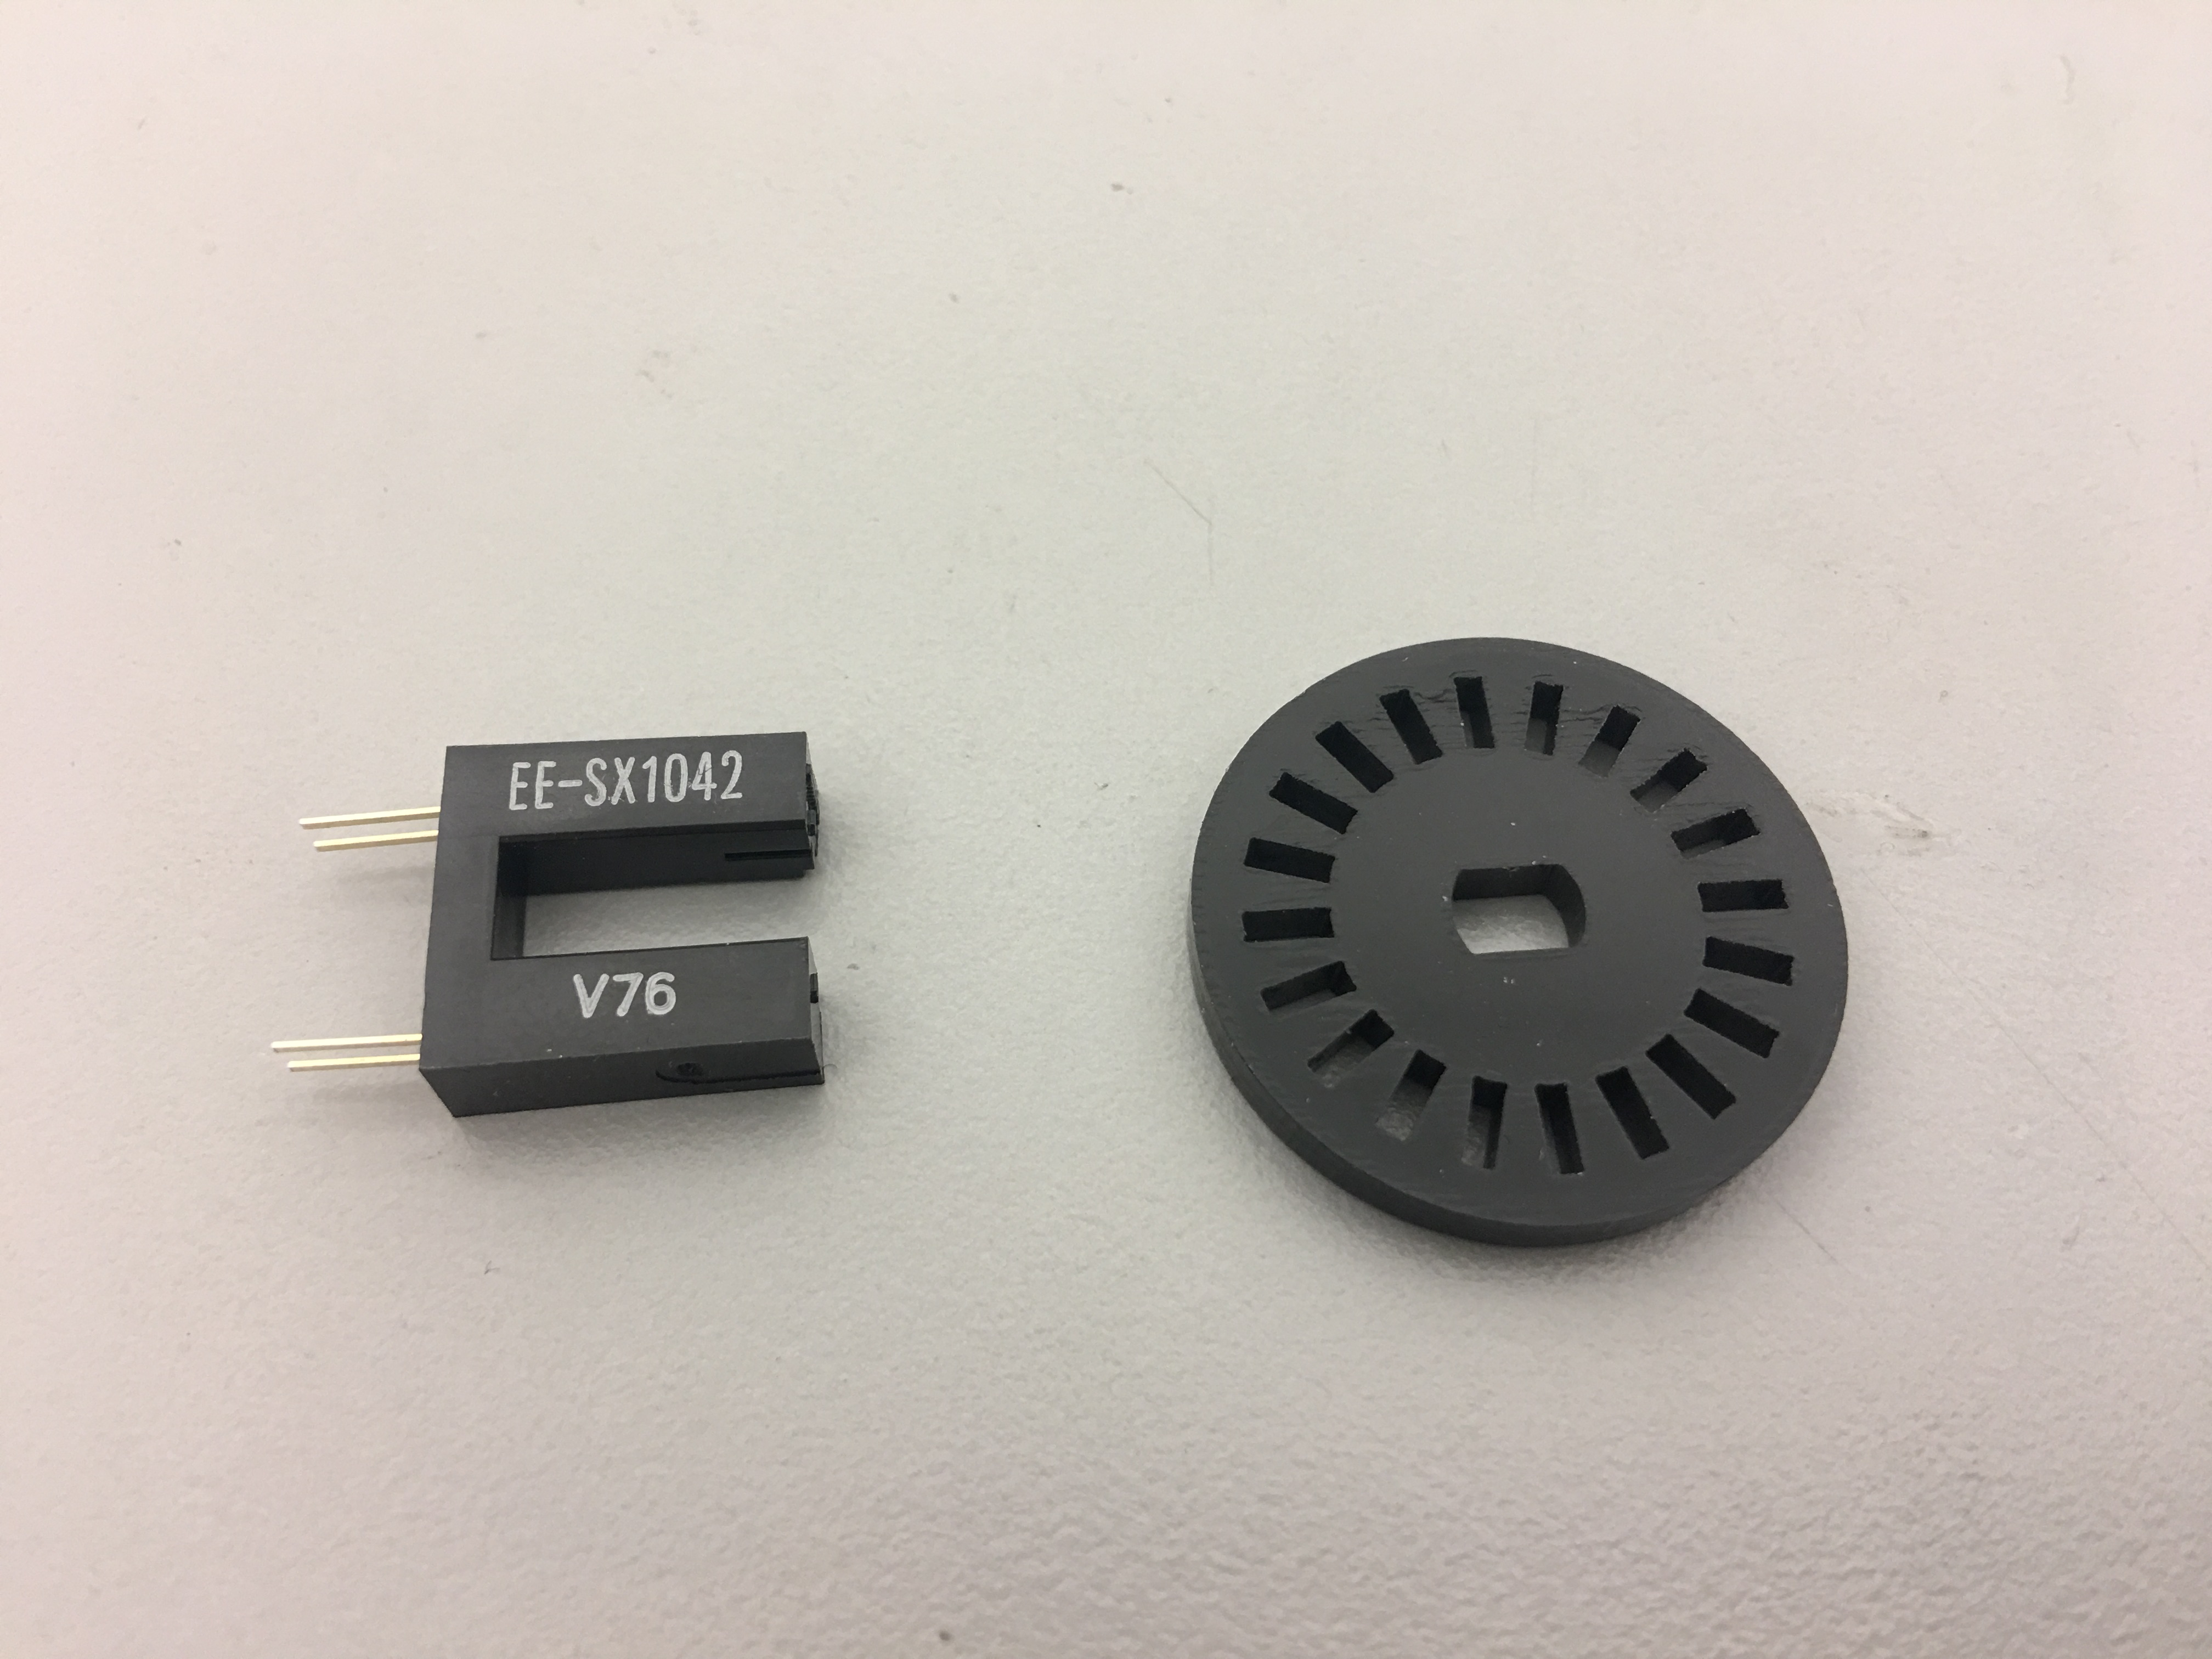
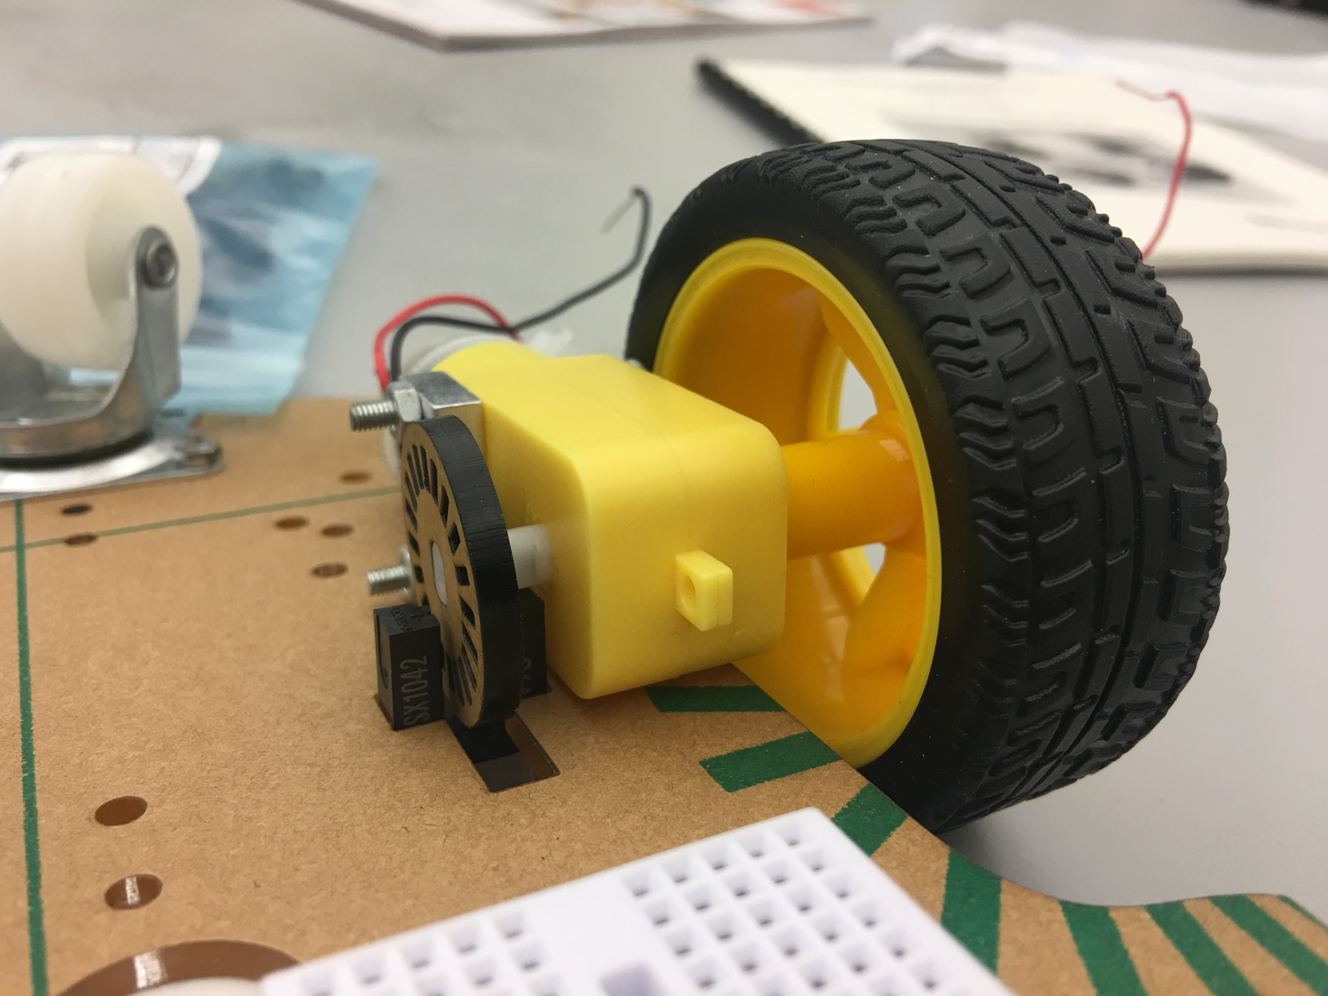
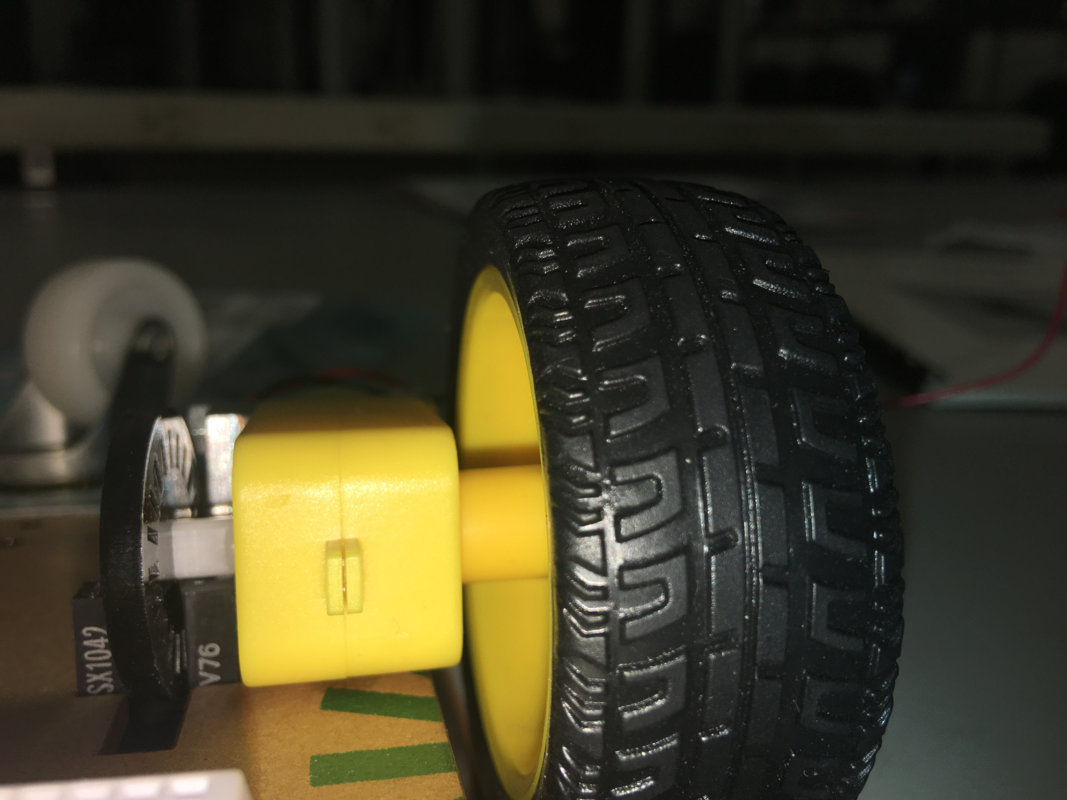
The Car
Wheel Speed Sensing

Slide 14
The System
Block Diagram
n: Nano pin#
2 A
IR
Micro-
Controller
GND
5 V
VIN
Dn (3)
An
(3)
Dn
6 V
(3)
C
C
9 V
Dn
TIP
120
TIP
120
B
B
R,G,B
(3)
IR
E
E
PWM
SINGLE-POINT GROUND

Slide 15
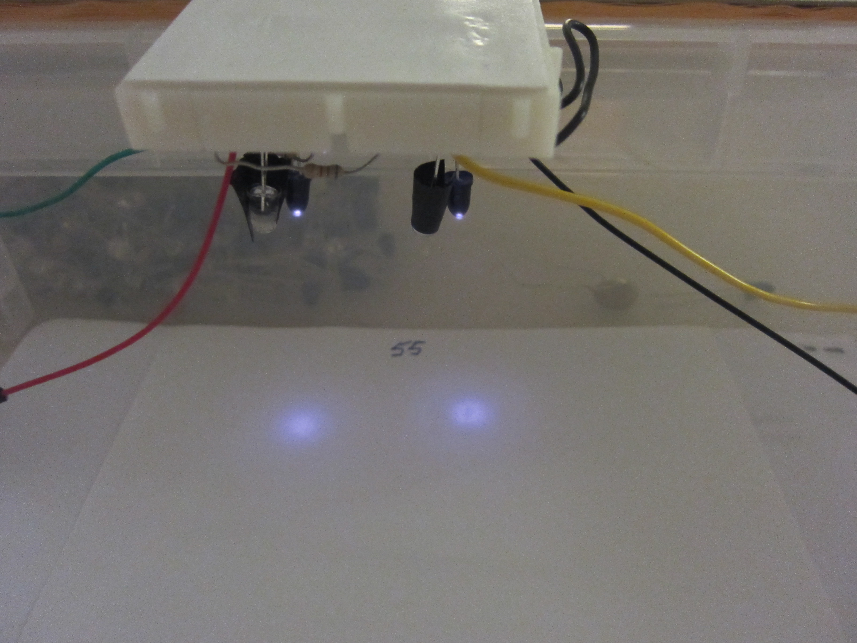
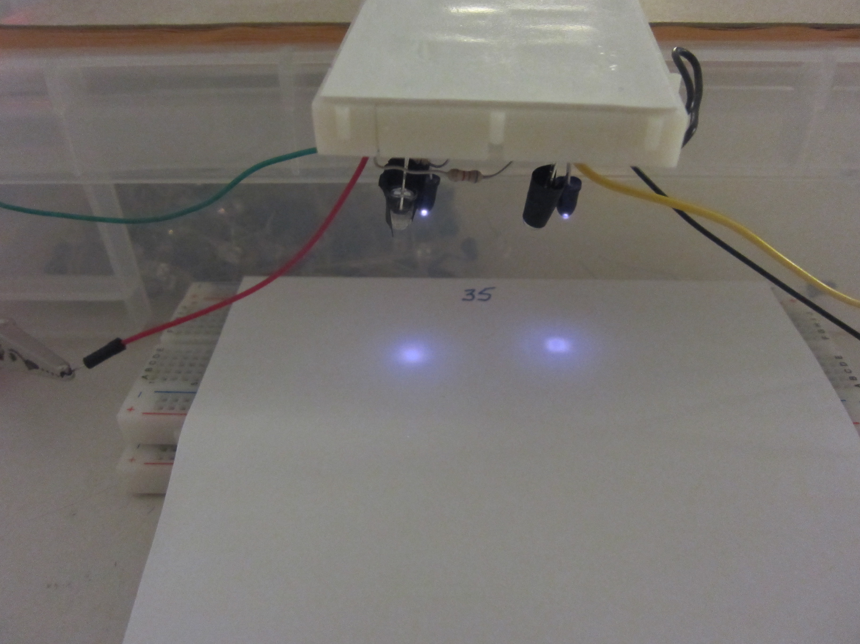
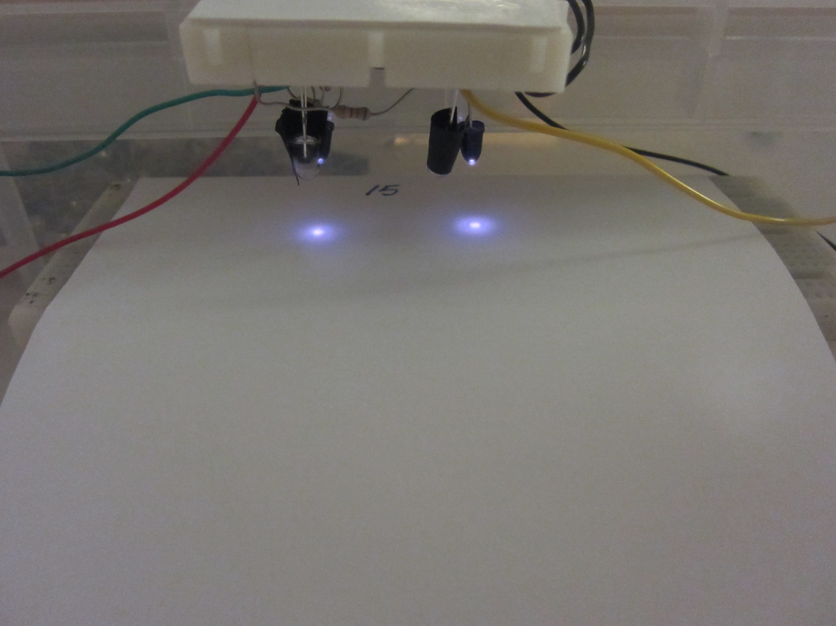

Slide 16
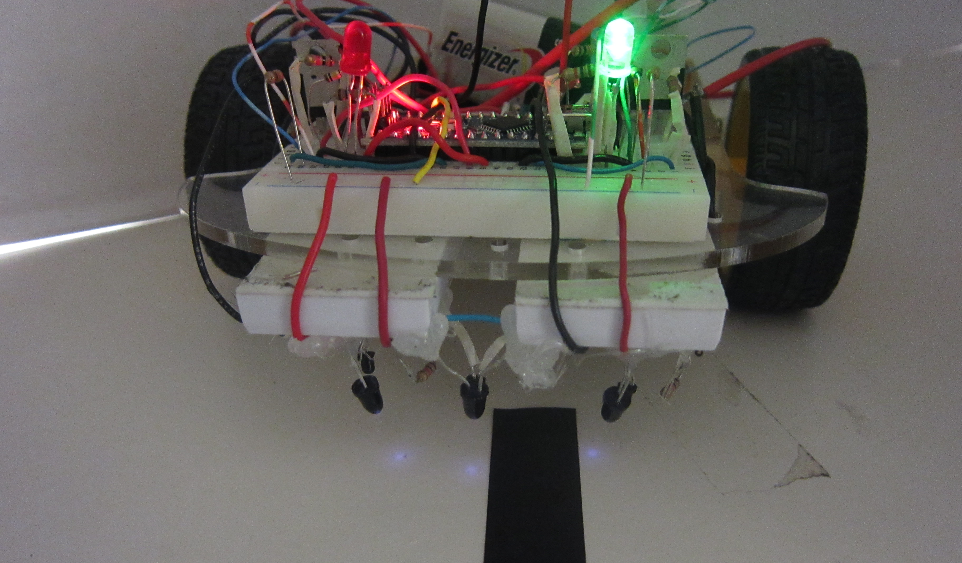

Slide 17
The Rules
Success of the project will be determined by the following criteria:
Ability to complete the track.
Ability to sense automatic stop.
(3-person teams) Ability to sense stopped motor and get it running again
Bragging rights depend on:
Time to complete the track
Distance covered along the track.
Extra Credit:
Available to 1- and 2-person teams only
Required for 3-person teams
Measure wheel speed to detect stopped motor.
Give car extra “kick” to get it started again.
Test for extra credit:
Hold the car in your hand.
At a low-speed PWM, apply just enough friction to stop the wheel.
With the same amount of friction, the code must get the wheel moving again.

Slide 18
TIPS
Take pictures or videos as you go
“guardrail” vs. PID control approach
What is NOT single-point ground.
Some of the parts are far from perfect. That’s OK.
Use RED wires only for power, BLACK wires only for ground.
Try to establish a color code for your wires so they are easier to follow.

